Slide 1
Lecture 25

Slide 2
Lecture 25 objectives
Understand and describe the regulation of fatty acid metabolism
Apply knowledge of fatty acid metabolism regulation to understanding starvation and diabetic responses

Slide 3
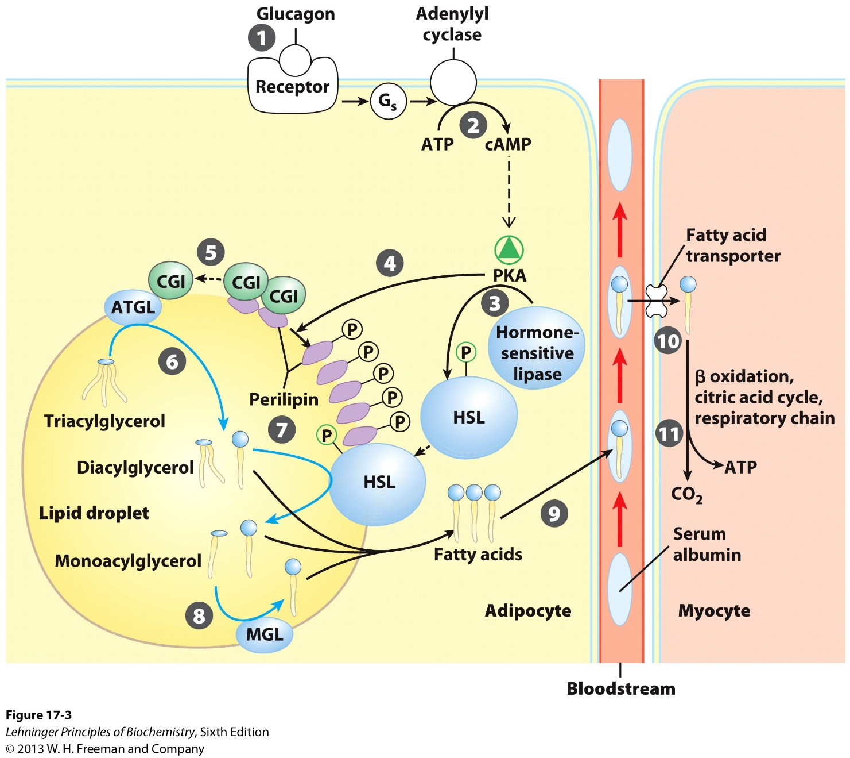
Hormonal regulation

Slide 4
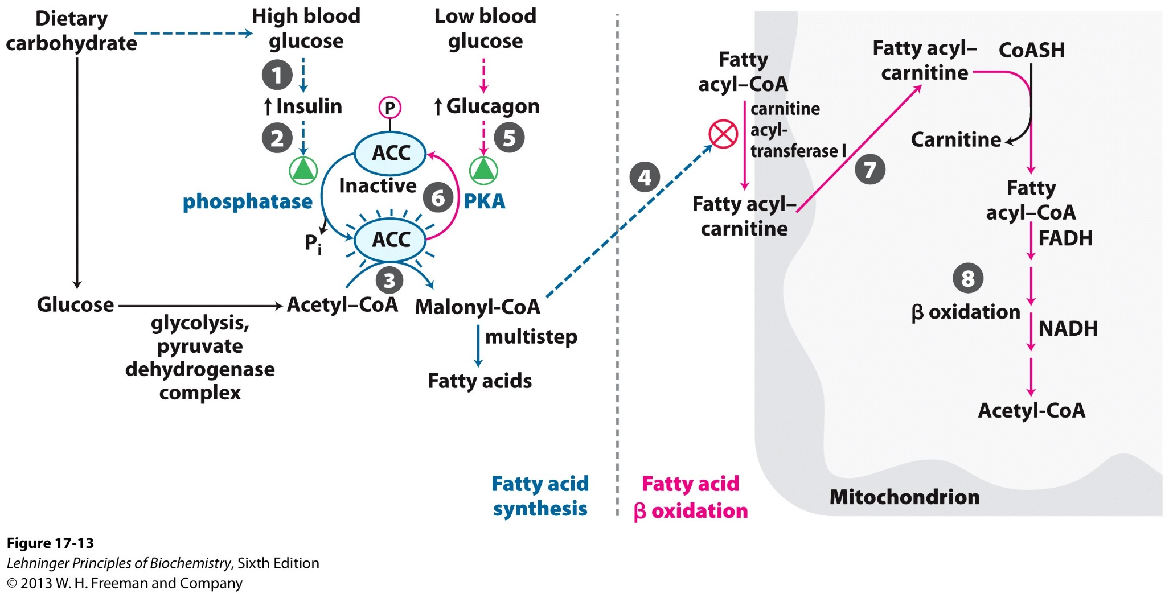
Regulation of FAS & breakdown

Slide 5
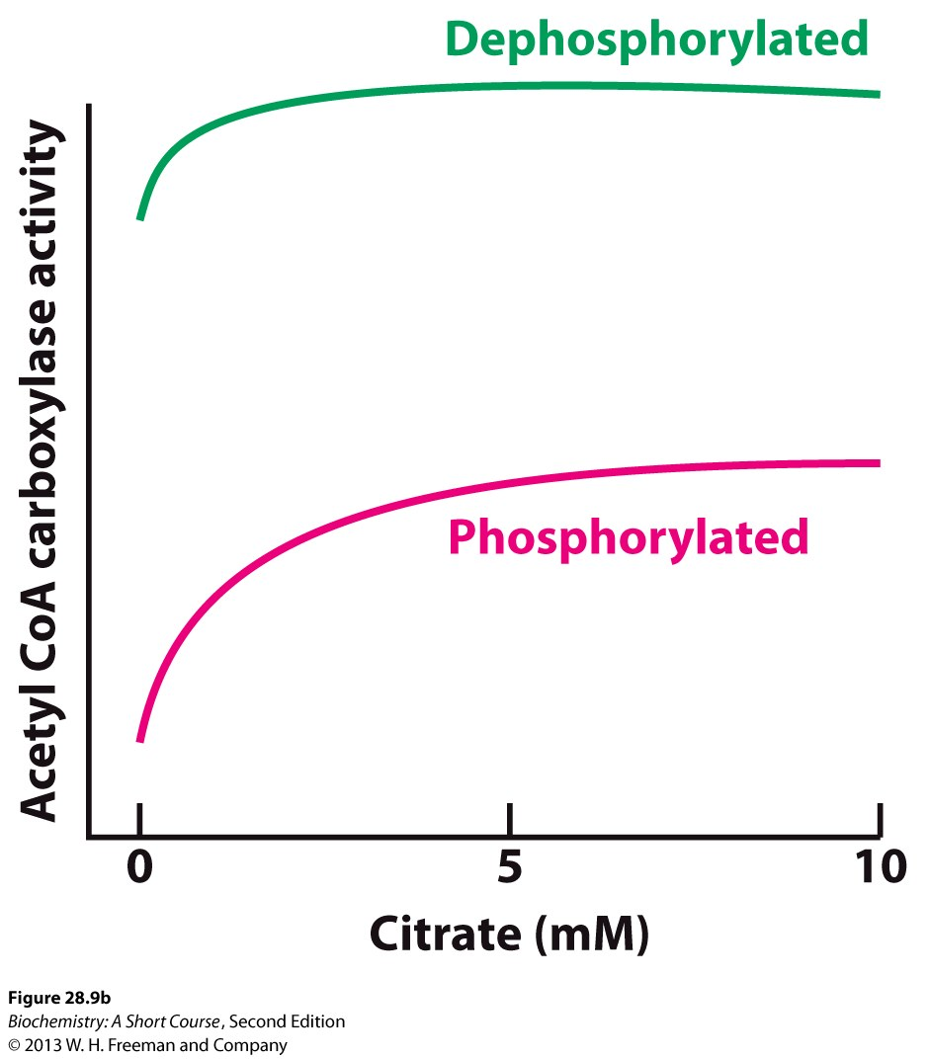
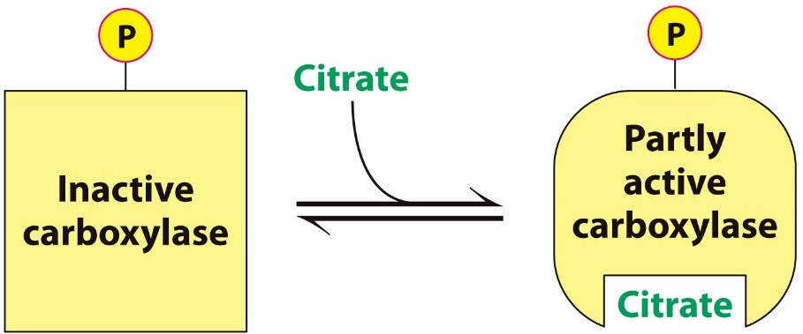
Allosteric regulation of ACC

Slide 6
The brain problem…
Most energy stored as fatty acids
Brain mostly uses
Fatty acids → Glc?
How does brain function during starvation?

Slide 7


Production of ketone bodies
Starvation → Glycogen =
Amino acids →
Muscles can use fatty acids ($↓$)
In liver, Gluconeogenesis $↓$ , so $↓$
Liver is also making from β-oxidation
Without TCA, liver makes “ ” from fats

Slide 8
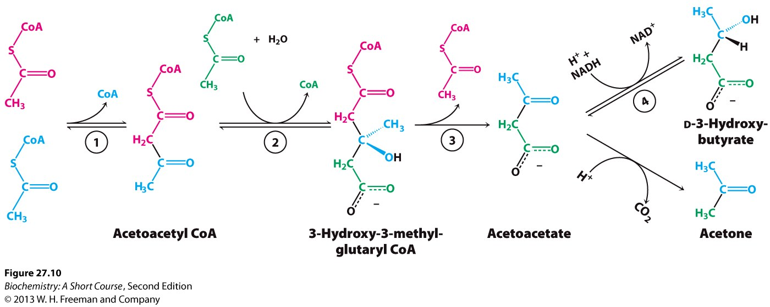
Ketone bodies

Slide 9

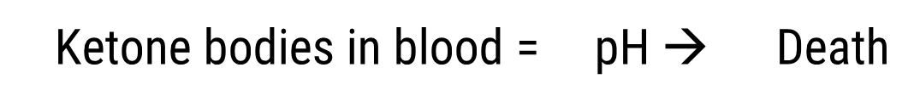

Diabetes & ketone bodies
Starvation → → Used by brain, body
Extreme starvation →
No insulin → Blood sugar, AND no FA breakdown
Too much Acetyl CoA → $↑$
Brain has plenty of Glc!
Ketone bodies in blood = pH → Death

Slide 10
Ketone bodies
High protein/Low carb diet can initially lead to mild ketosis. Why/How?

